Slide 1
Data Science: Zero to Hero
@GaryShort
@GaliyaWarrier

Slide 2
Agenda
Housekeeping
Part 1: Basics of Statistics
Part 2: Supervised Learning
Part 3: Unsupervised Learning
Part 4: Deep Learning
Notes:
10 min – Intro & Housekeeoing
50 min – 10 (slides) + 30 (lab) + 10 (Q&A)
50
50
50
15 min – wrap & up / takeways / …
15 (?) - contingency

Slide 3
Housekeeping
Pre-requisites and tutorial materials are available:
https://github.com/galiya/ML-Tutorial-Codemash2019
If you haven’t installed Anaconda env – don’t. We’ve DDOS’d it ☺

Slide 4
Part 1: Basics of Statistics

Slide 5
Let’s start at the beginning…

Slide 6
There are only 4 data types…

Slide 7
They are easy to remember because the following types are the same as the one before, only more constrained

Slide 8
Type 1: Categorical / Nominal

Slide 9
Type 2: Ordinal

Slide 10
Type 3: Continuous

Slide 11
Type 4: Ratio

Slide 12
So statistics is simply making a comparison between two or more measures of those types

Slide 13
Or making a comparison between two or more groups of those data types.

Slide 14
In order to achieve one or more of the 3 kinds of statistics

Slide 15
Descriptive

Slide 16
Predictive

Slide 17
Prescriptive

Slide 18
Measure something
Compare 2 or more measures
Describe
Predict
Prescribe
Calculate the error
Make a correction

Slide 19
Let’s do it!

Slide 20
Part 2: Supervised Learning

Slide 21
What are we trying to predict?
Given the set of input values

Slide 22
Numerical value
Regression
Age, salary, weight, house price, ….
Notes:
What are you trying to predict? A numerical value or a category?

Slide 23
Categorical value
Classification
* Spam vs. Not Spam, Disease vs. No Disease * Positive vs. Neutral vs. Negative, Customer segmentation
Notes:
Propensity model (buy / not buy)
Which channel to buy -> multi-label

Slide 24
Y = F(x)
Y = output variable x = a set of input variables

Slide 25
Find the “best” fitting function
Core of Supervised Learning techniques
Notes:
The “best” function that helps to draw conclusion from the observed values. Given one or more inputs a supervised model will try to predict the value of one or more outcomes.

Slide 26
F(x): Linear vs. Non-Linear

Slide 27
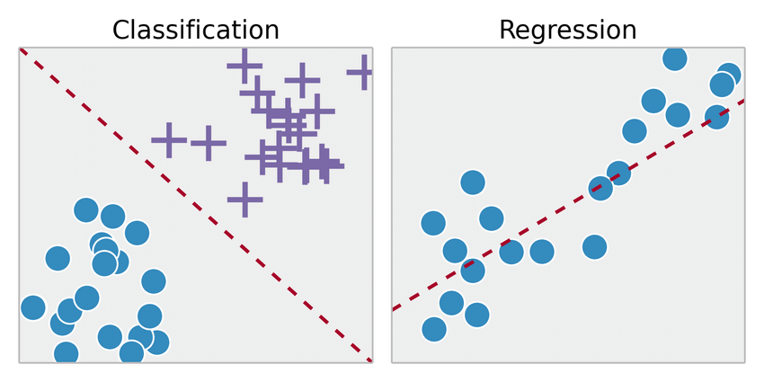
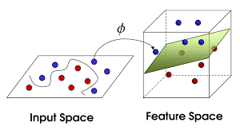

Slide 28
Let’s look at our data now!

Slide 29
Part 3: Unsupervised Learning

Slide 30
Part 4: Deep Learning

Slide 31
Measure something
Compare 2 or more measures
Describe
Predict
Prescribe
Calculate the error
Make a correction

Slide 32
Imagine doing the same process but at scale
Image recognition, speech-to-text, NLP, games, …

Slide 33
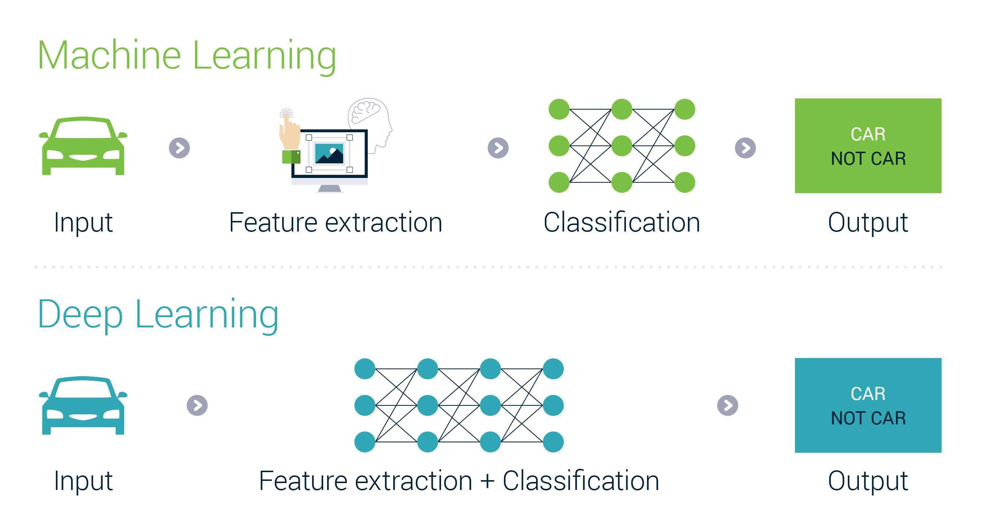

Slide 34
Deep learning systems “learn” data representations from data

Slide 35
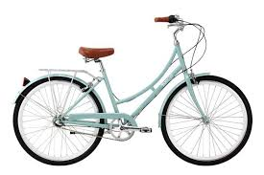
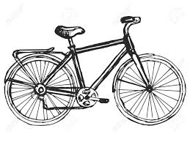
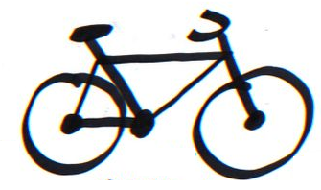

Slide 36
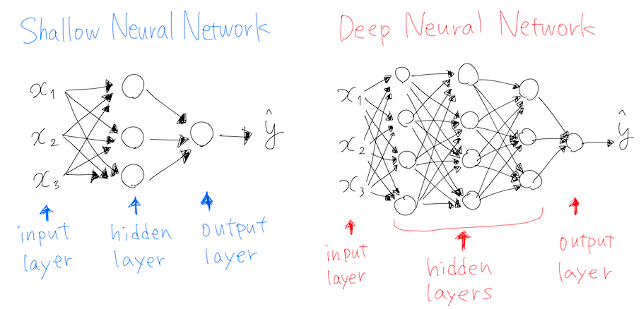
Layers in Neural Networks
“Deep” == “More than 1 hidden layer”

Slide 37
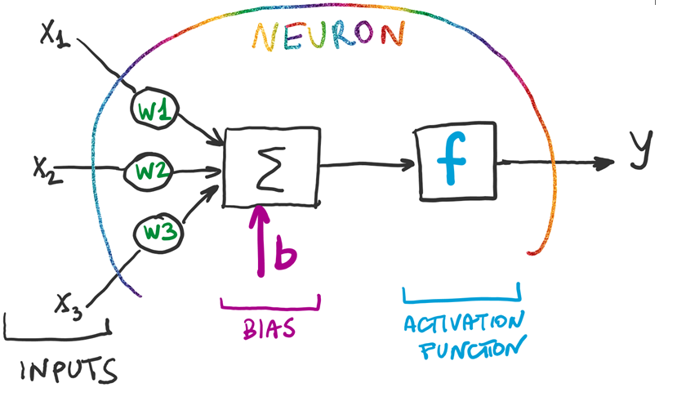
What is a Neuron?

Slide 38
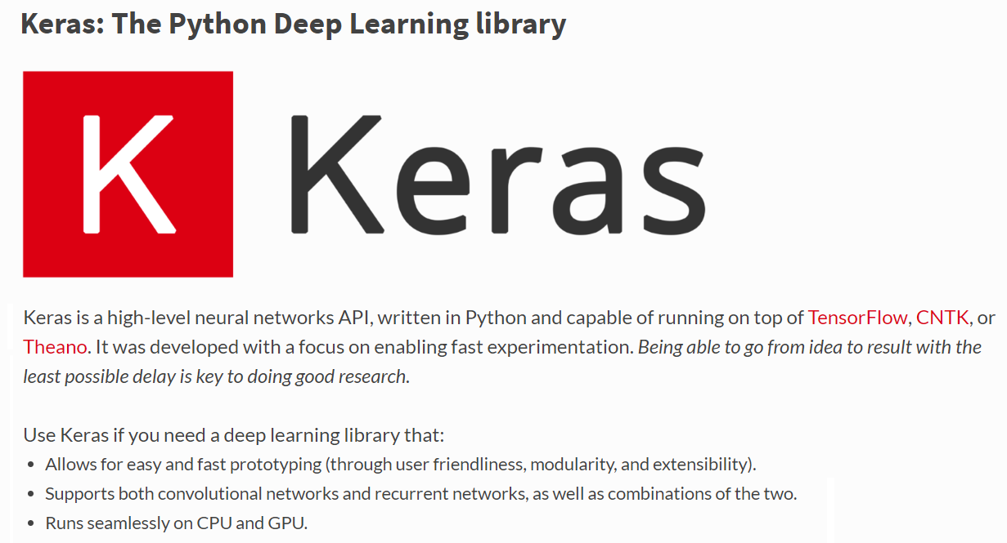

Slide 39
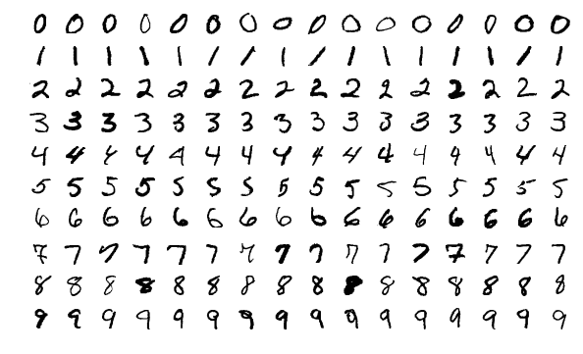
MNIST Classification

Slide 40
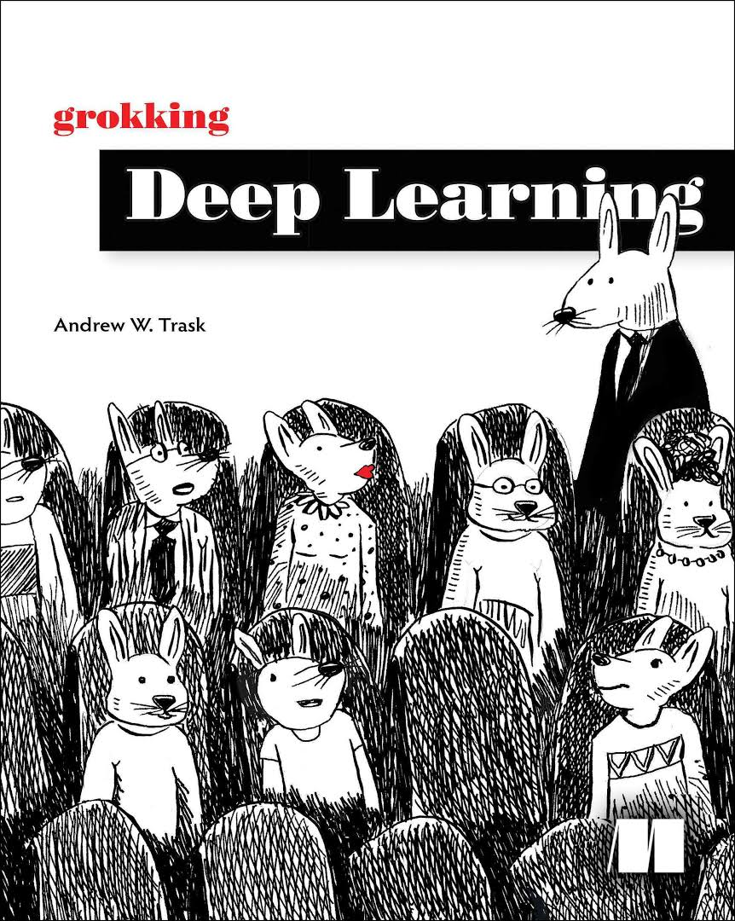

Deep Learning: Resources

Slide 41
Thank you!

